Slide 1
Authorization (ACL & Capabilities)

Slide 2
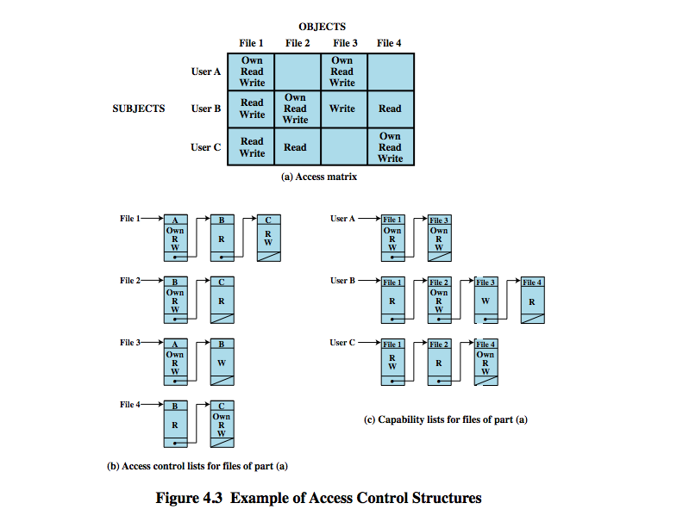
Access Control structures

Slide 3
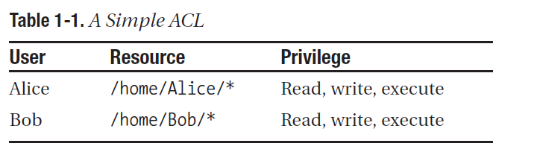
Access Control Lists (ACLs)
Minimally, an ACL is a set of users and a corresponding set of resources they are allowed to access.

Slide 4
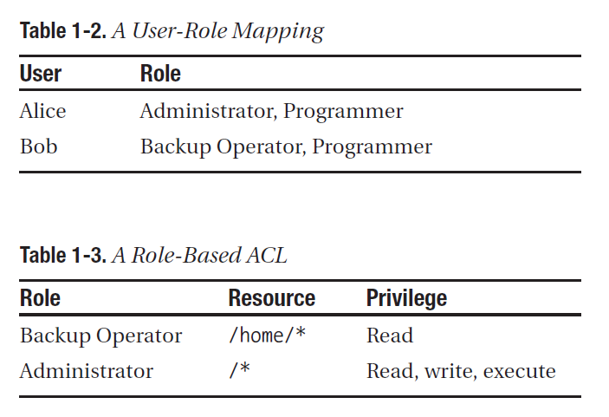

Slide 5
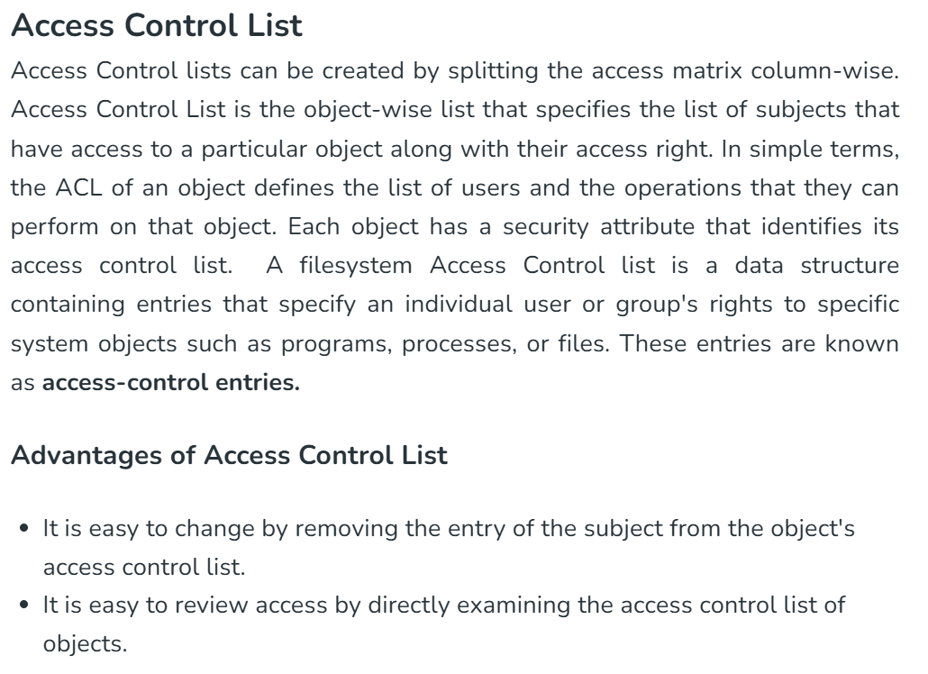

Slide 6
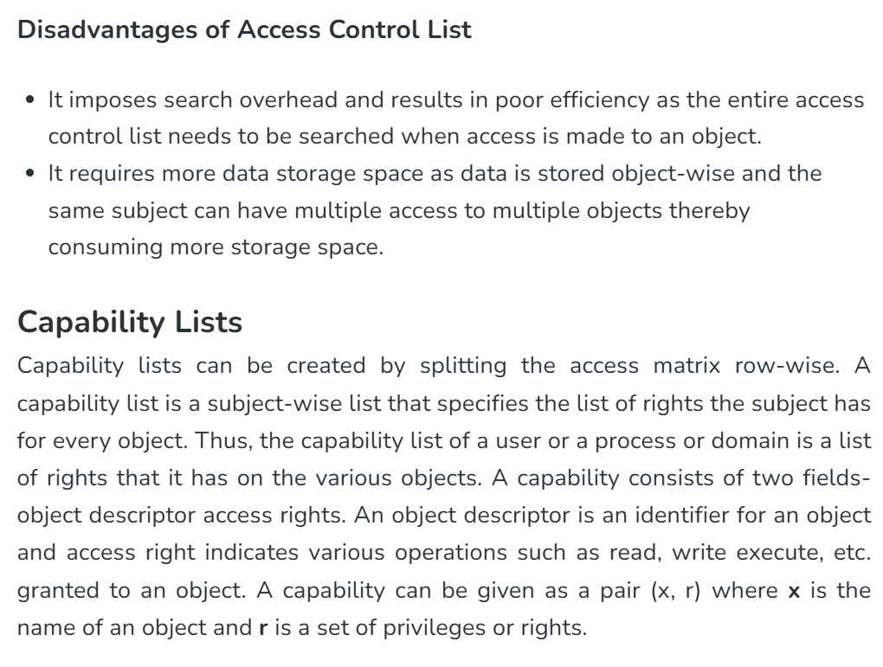

Slide 7
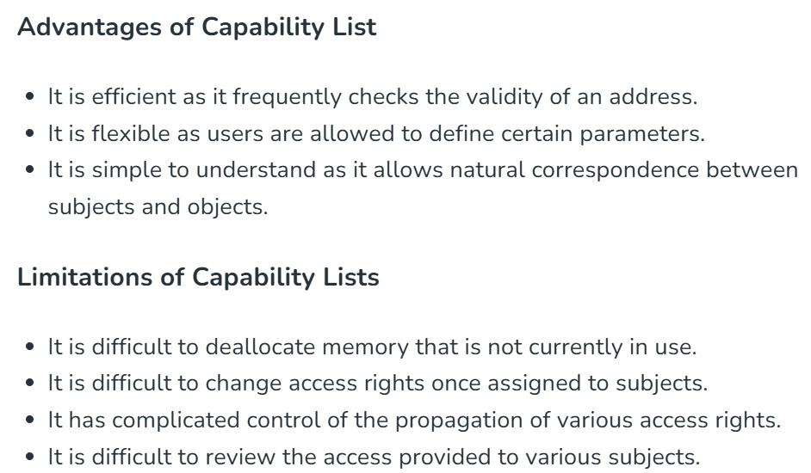

Slide 8
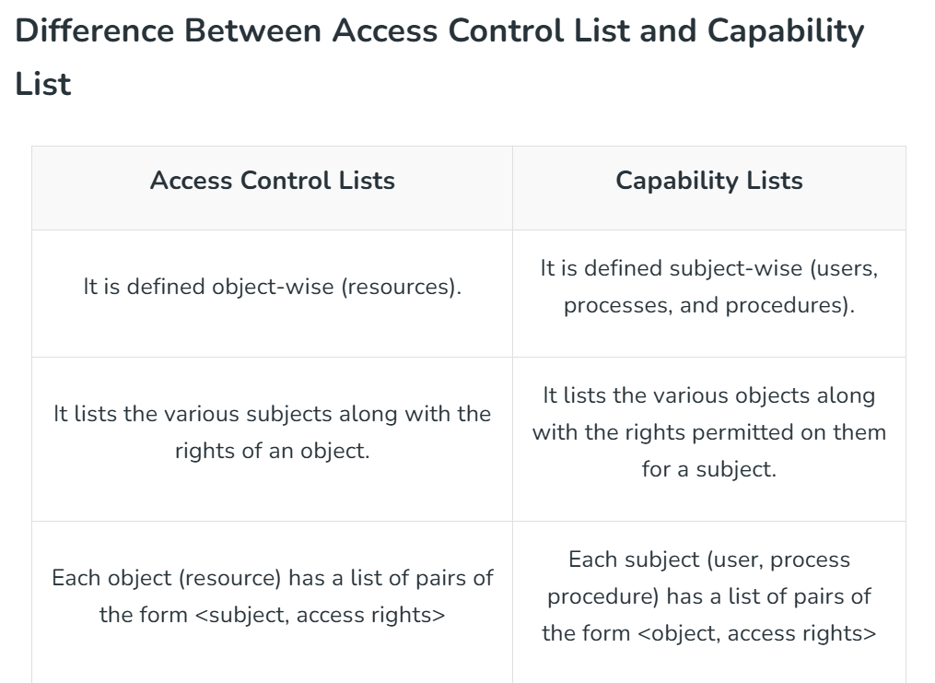
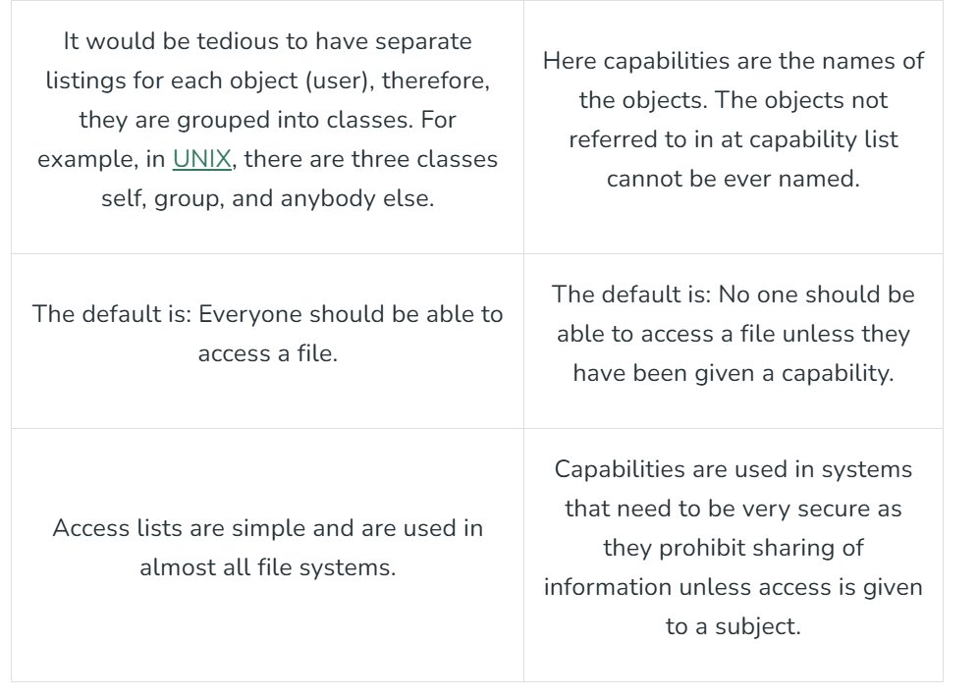

Slide 9
In what aspects, capability is better than ACL?
ACLs are suited to environments where protection is data-oriented; they are less suited where the user population is large and constantly changing, or where users want to be able to delegate their authority to run a particular program to another user for some set period of time.
ACLs are simple to implement, but are not efficient as a means of doing security checking at runtime, as the typical operating system knows which user is running a particular program, rather than what files it has been authorized to access since it was invoked. The operating system must either check the ACL at each file access, or keep track of the active access rights in some other way.
Finally, distributing the access rules into ACLs means that it can be tedious to find all the files to which a user has access. Revoking the access of an employee who has just been fired will usually have to be done by cancelling their password or other authentication mechanism. It may also be tedious to run system-wide checks; for example, verifying that no files have been left world-writable could involve checking ACLs on millions of user files.

Slide 10
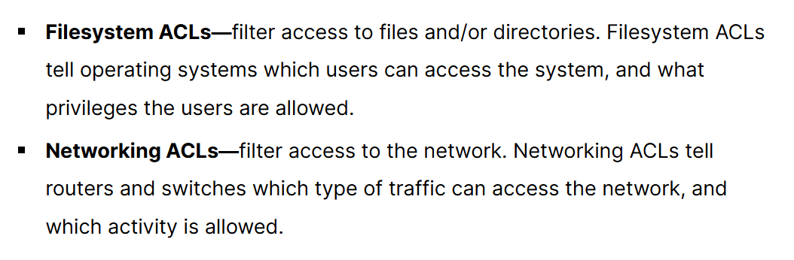
Types of ACL (based on filetype)

Slide 11
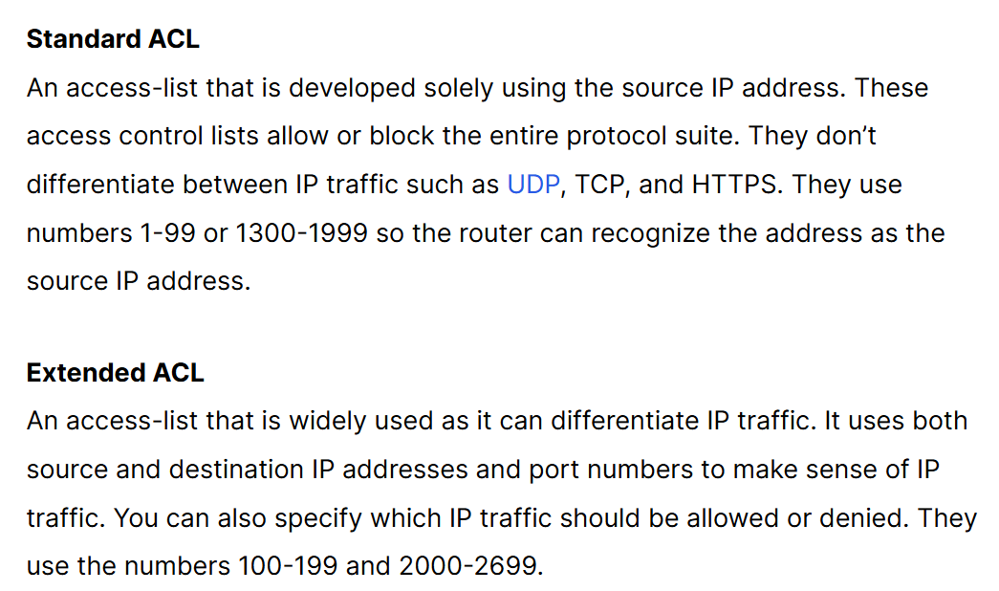
Types of networking ACL

Slide 12
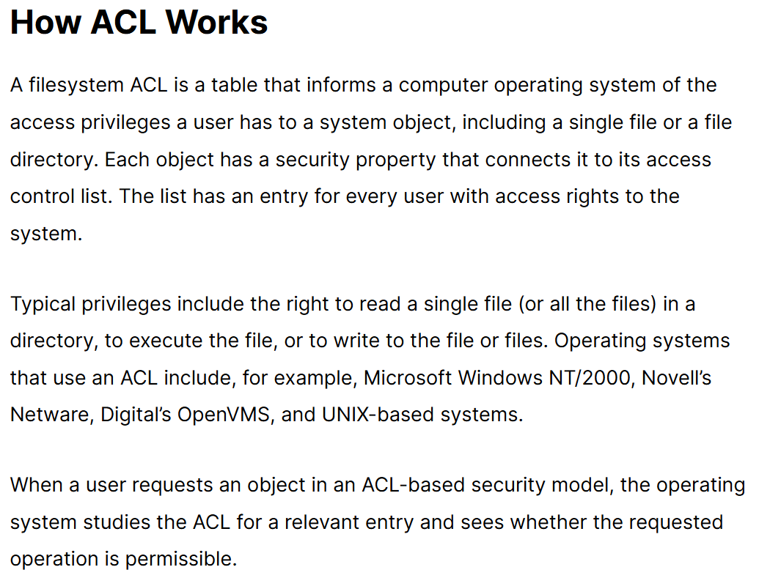

Slide 13
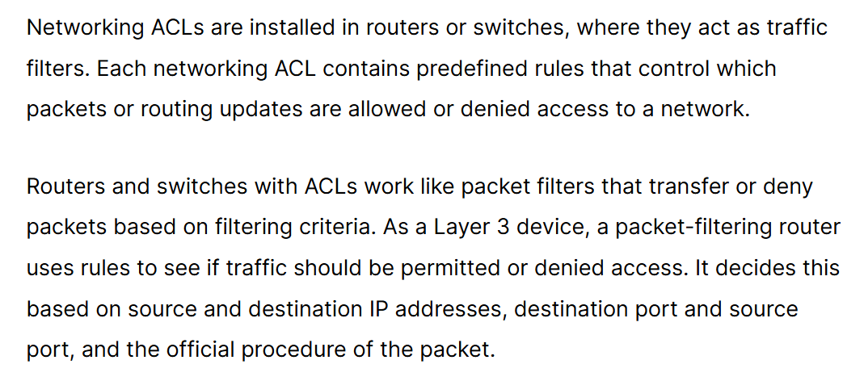

Slide 14
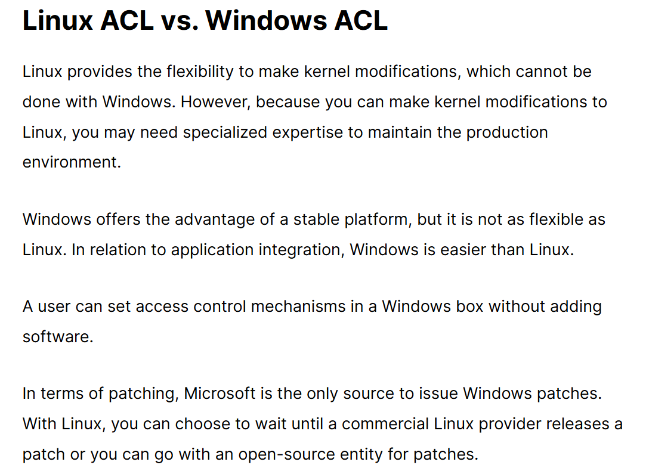

Slide 15
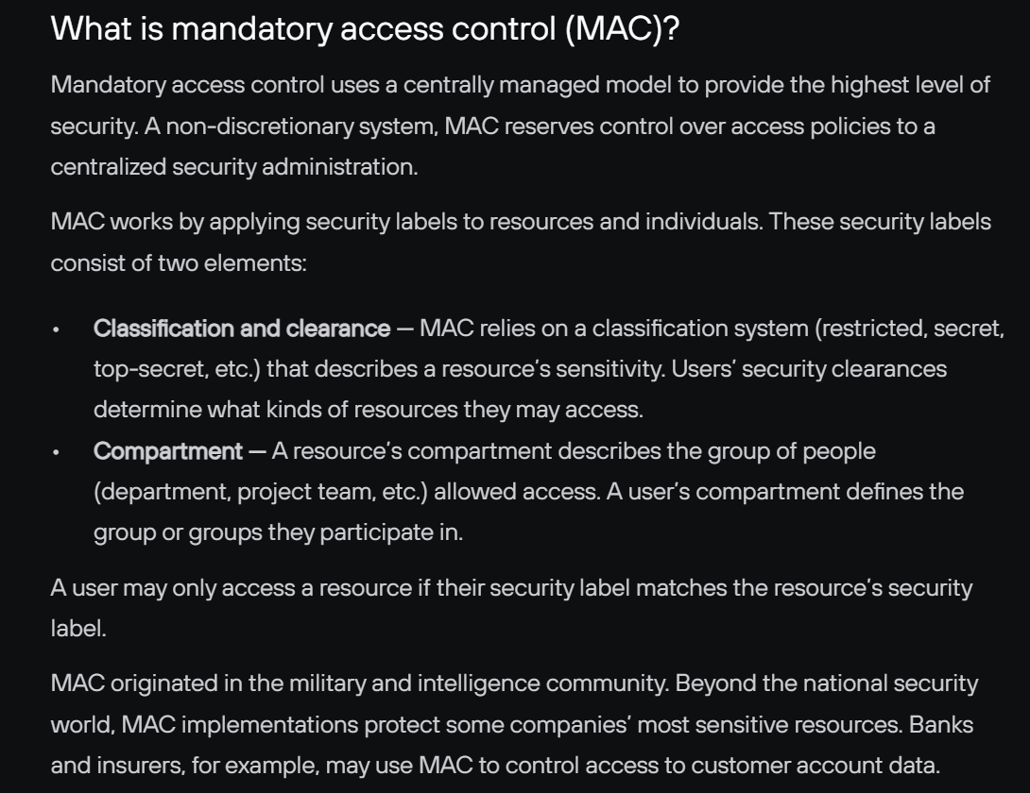

Slide 16
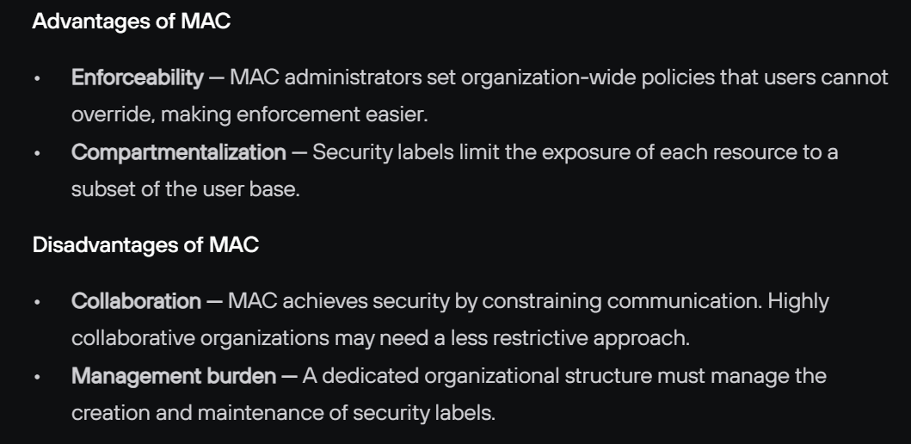

Slide 17
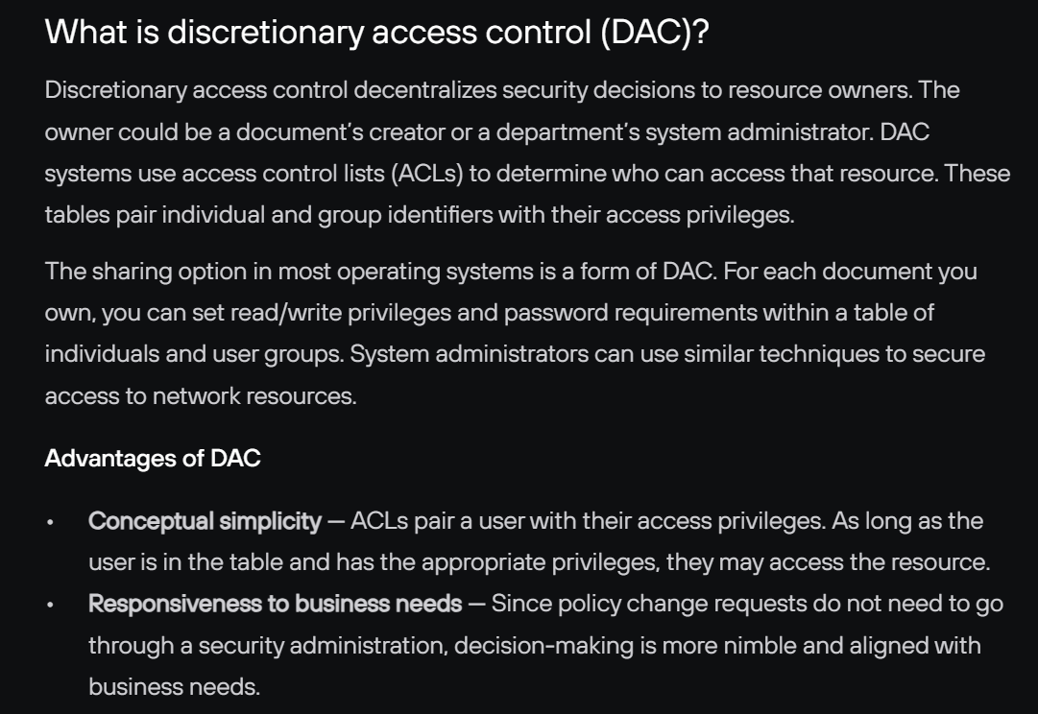

Slide 18
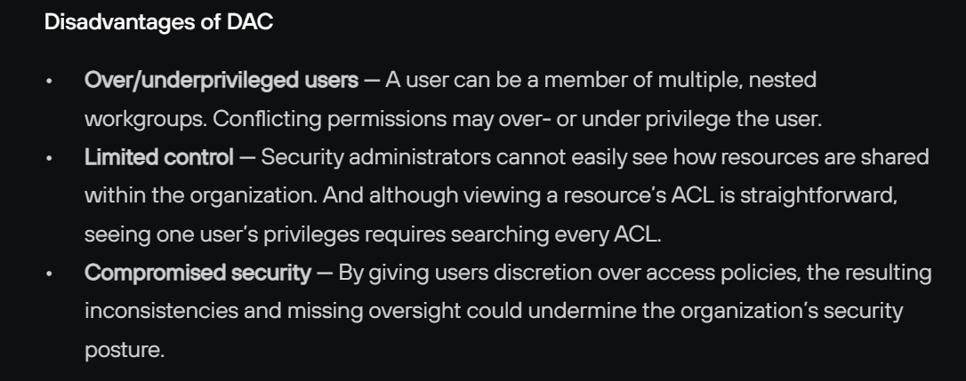
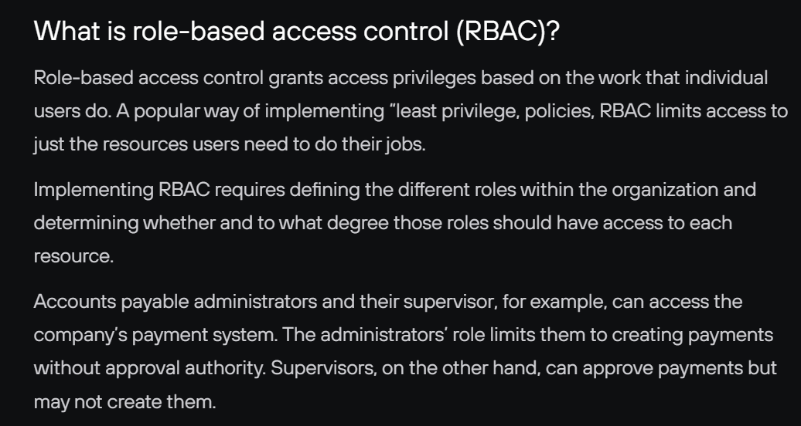

Slide 19
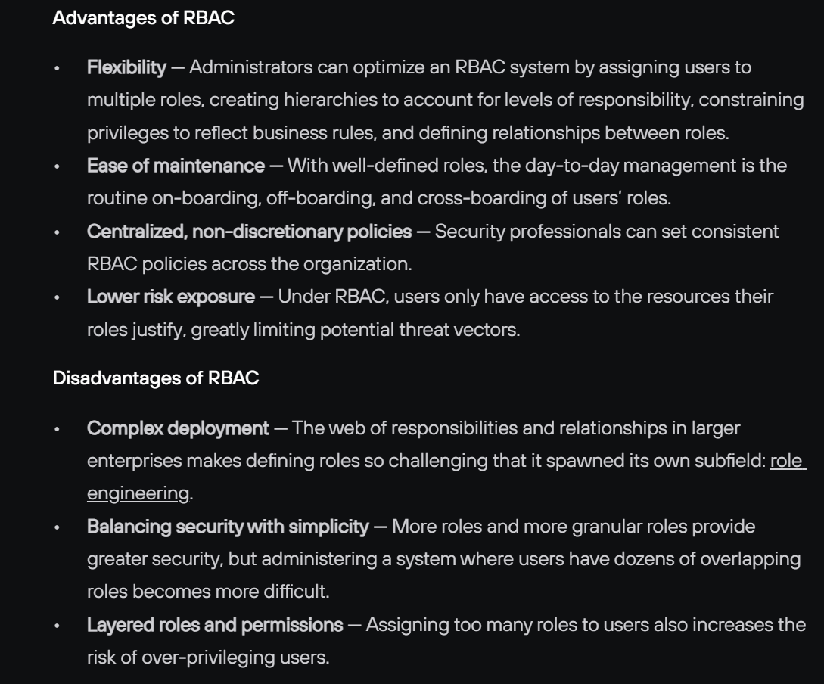

Slide 20
Thank you
Dr. Rachaita Dutta
Assistant professor
Dept. of mca
  9007223301
  rachaitadutta@my.amrita.edu

